Slide 1
Machine Learning with SQL Server
Part 1 - Machine Learning with SQL Server ML Services
Marcin Szeliga

Slide 2




Marcin Szeliga
Data Philosopher
Over 20 years of Professional experience
Artificial Intelligence MVP & MCT
Microsoft Certified Solutions Expert
Data Management and Analytics
Cloud Platform and Infrastructure
Business Intelligence
Microsoft Certified Solutions Developer
Azure Solution Architect
marcin.szeliga@datacommunity.pl

Slide 3

Agenda
Data Science and Machine Learning
SQL Server Machine Learning Services
By Kenneth Jensen - own work based on: ftp://public.dhe.ibm.com/software/analytics/spss/documentation/modeler/18.0/en/ModelerCRISPDM.pdf (Figure 1), CC BY-SA 3.0, https://commons.wikimedia.org/w/index.php?curid=24930610

Slide 4
Data Science and Machine Learning

Slide 5

Data Science and Machine Learning
Source: Nvidia

Slide 6
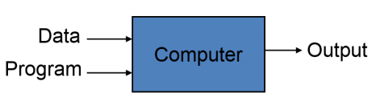
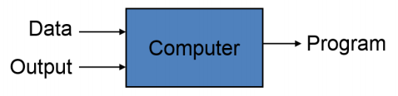
Machine Learning
A computer program is said to learn from experience E with respect to some class of tasks T and performance measure P if its performance at tasks in T, as measured by P, improves with experience E
Name
Amount
Fraud ?
Mitchell, T. (1997). Machine Learning. McGraw Hill. p. 2. ISBN 978-0-07-042807-2
Smith
$2,600.45
No
Potter
$2,294.58
Yes
Peters
$1,003.30
Yes
Adams
$8,488.32
No

Slide 7
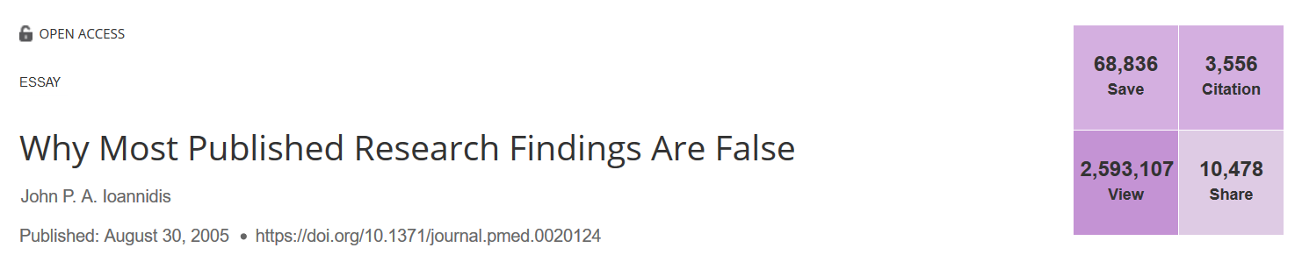
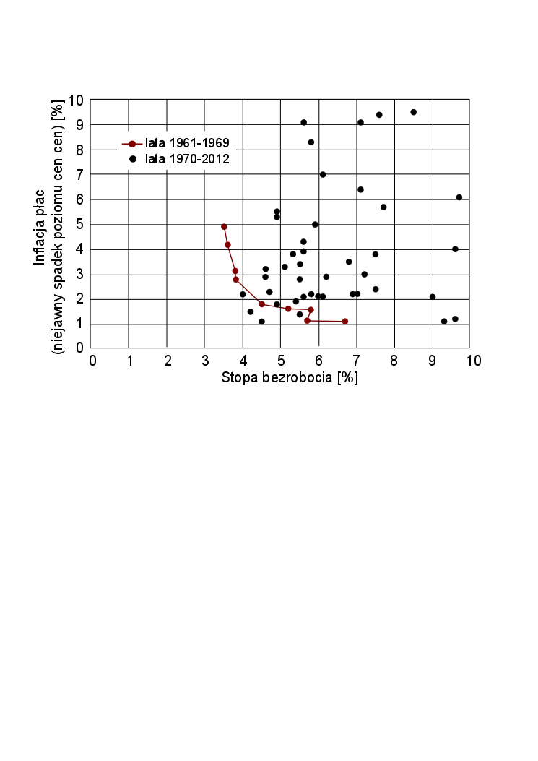
Why we need Data Science
Phillips curve is a single-equation econometric model describing a historical inverse relationship between rates of unemployment and corresponding rates of rises in wages
Since 1974, seven Nobel Prizes have been given to economists for work critical of some variations of the Phillips curve

Slide 8
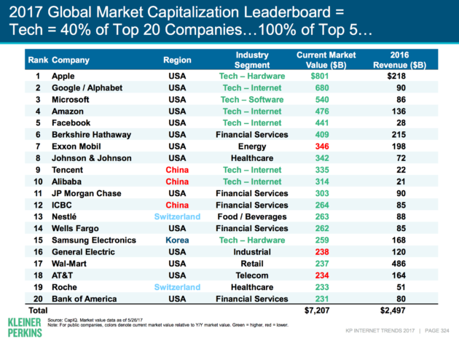
Data is the new oil, AI is the new electricity

Slide 9
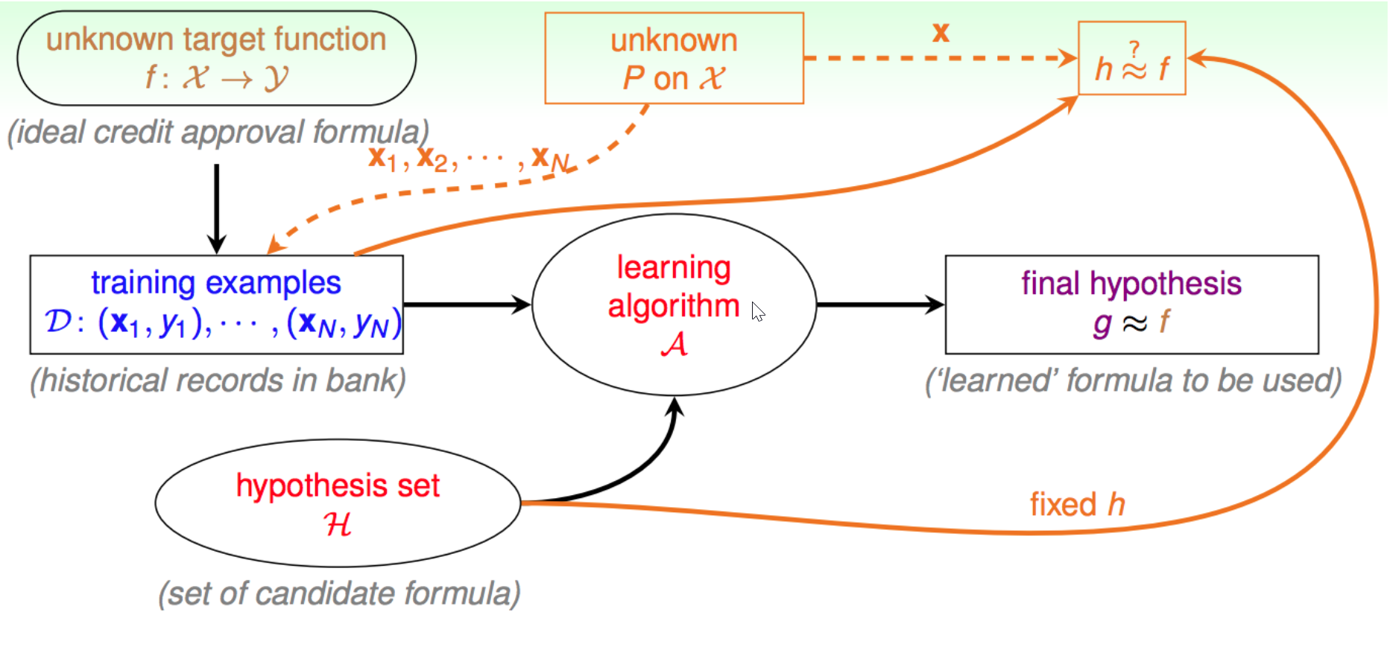
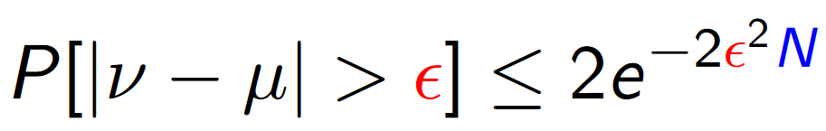
Is Machine Learning feasible ?
Learning process
Check all the possible functions
Choose the one that fits all the data
We have only sample data
In big sample (large N), ν (sample mean) is probably close to μ
Hoeffding's inequality
By Cho-Jui Hsieh UC Davis

Slide 10
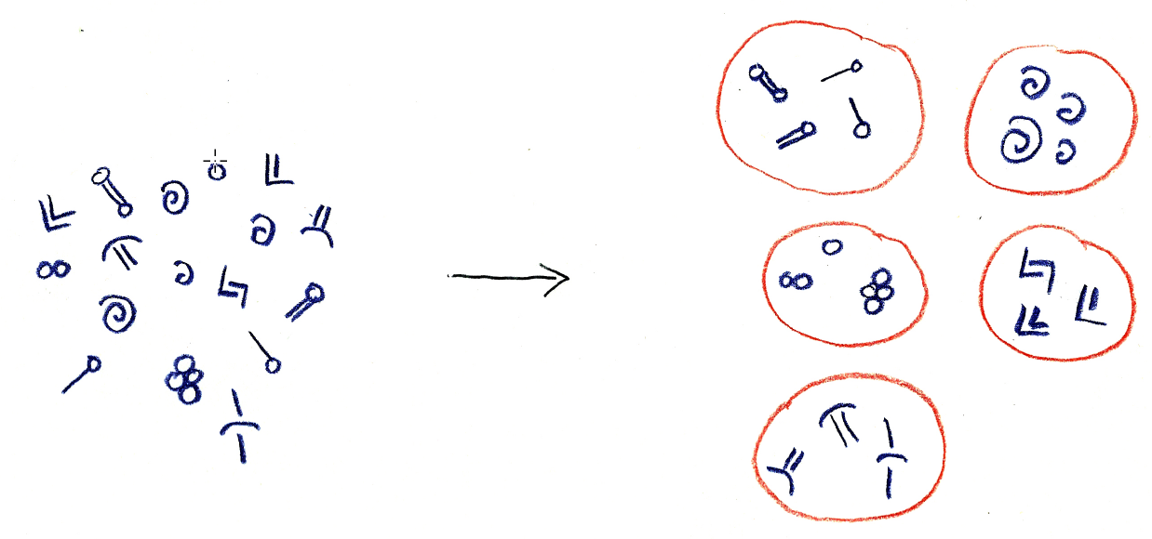

Unsupervised learning
Learning from data without labels
Use cases
Clustering
Dimensionality reduction
Anomaly detection
Autoencoders
Generative adversarial network
By Andrew Glassner, The Imaginary Institute

Slide 11
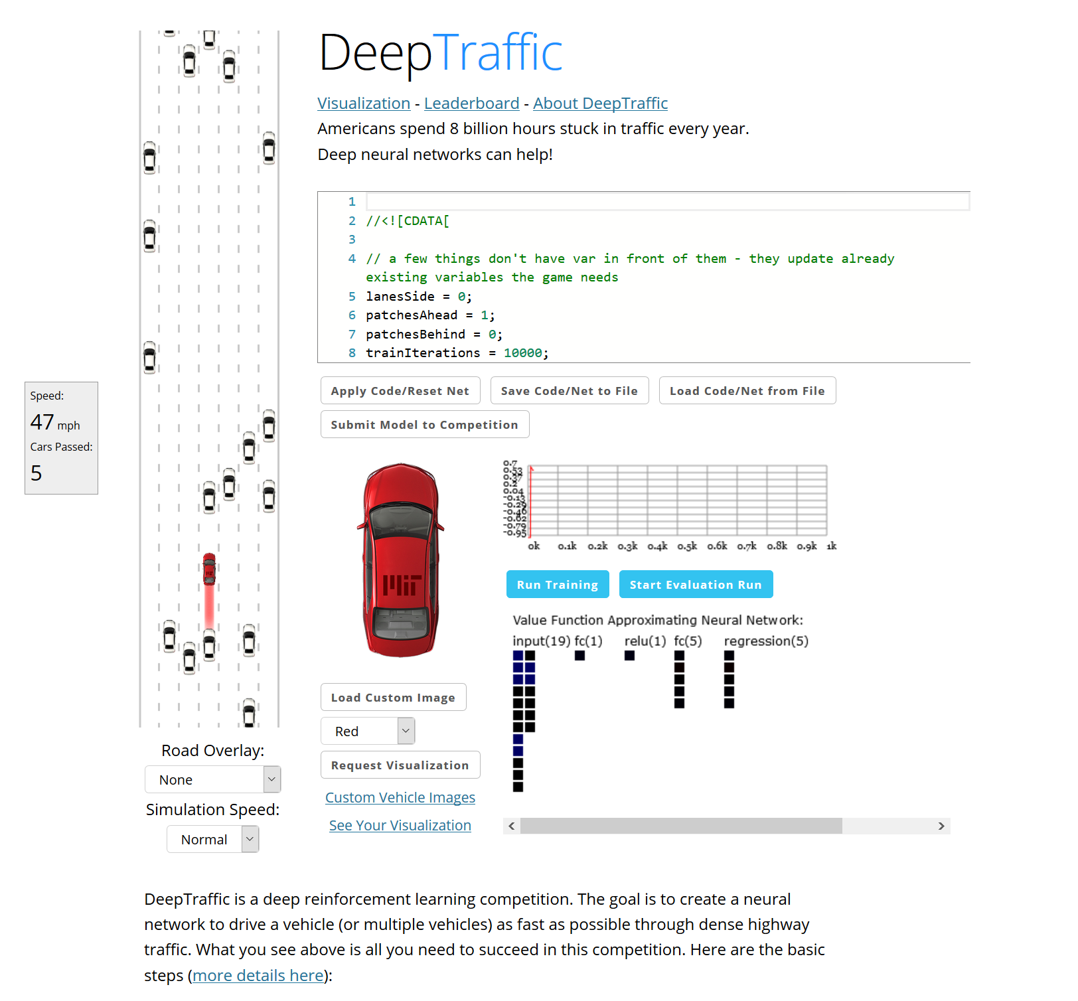
Reinforcement learning
Like training a pet - rewards for good behavior
Labels are not needed
Use cases
AlphaGo Zero
Robotics and industrial automation
Finding optimal treatment policies, trade execution, …
Text, speech, and dialog systems
https://selfdrivingcars.mit.edu/deeptraffic/

Slide 12
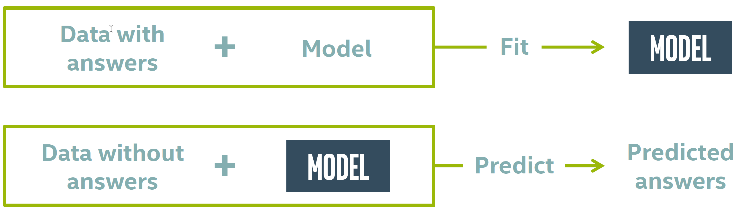
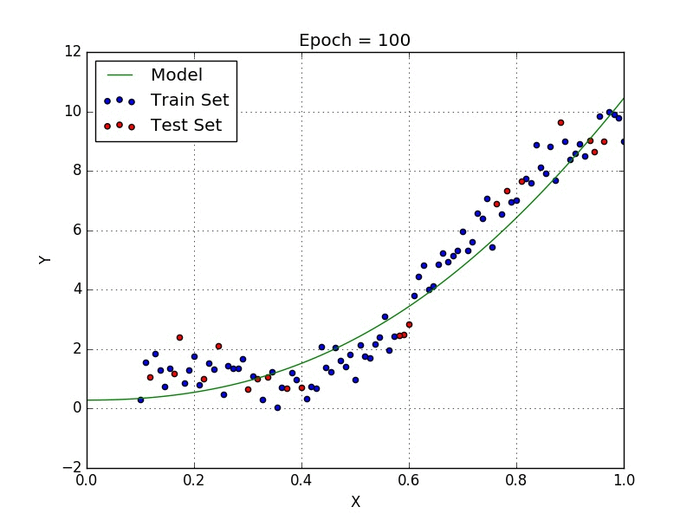
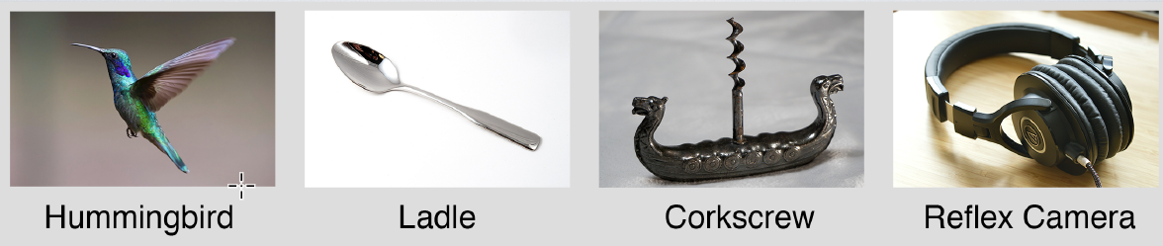
Supervised learning
Each piece of data must be labelled
The goal is to learn how to predict that label
Use cases
Regression
Classification
Recommendation
By Andrew Glassner, The Imaginary Institute
By Andrew Glassner, The Imaginary Institute

Slide 13
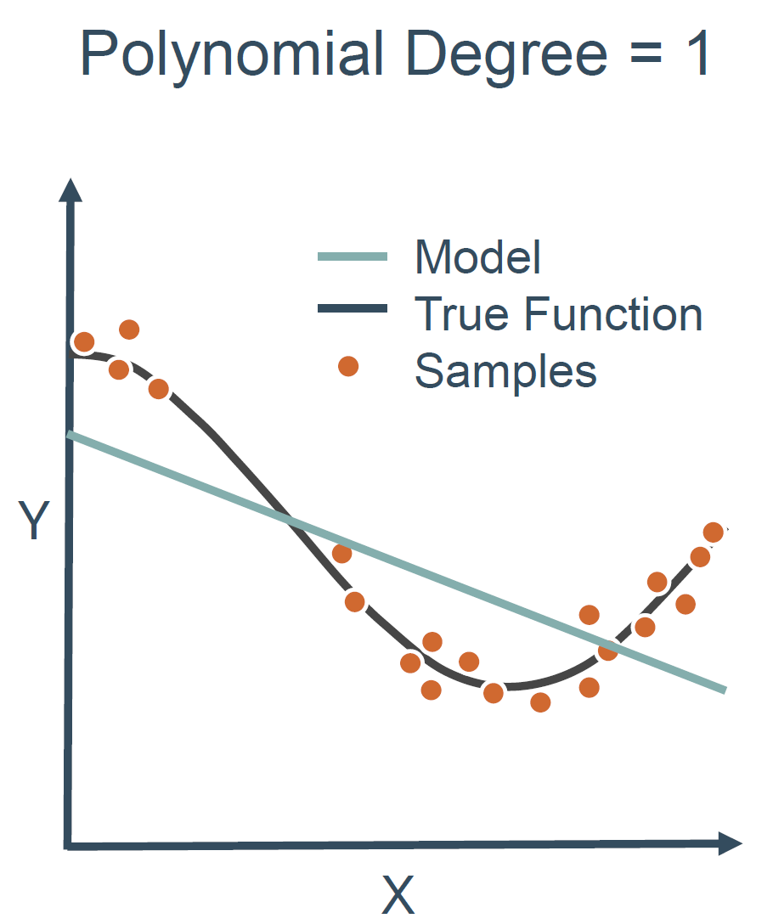
Underfitting
Model that can neither learn from training data nor generalize to new data
Easy to detect
Model is too simple
Wrong algorithm was used
Learning was too quick (wrong hyperparameters)
Data does not contains useful patterns

Slide 14
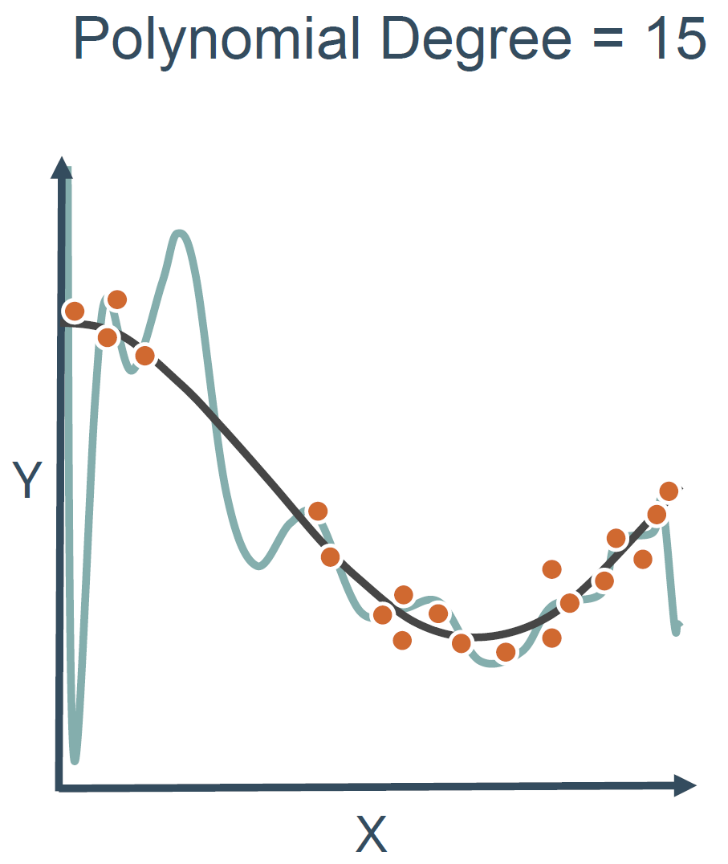
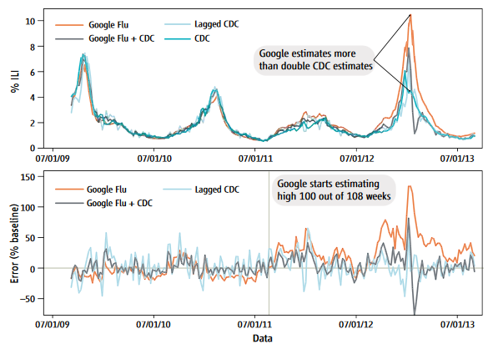
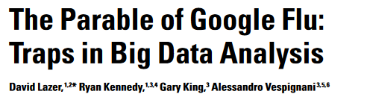
Overfitting (overtraining)
If model corresponds too closely or exactly to a particular set of data, it may fail to predict future observations reliably

Slide 15
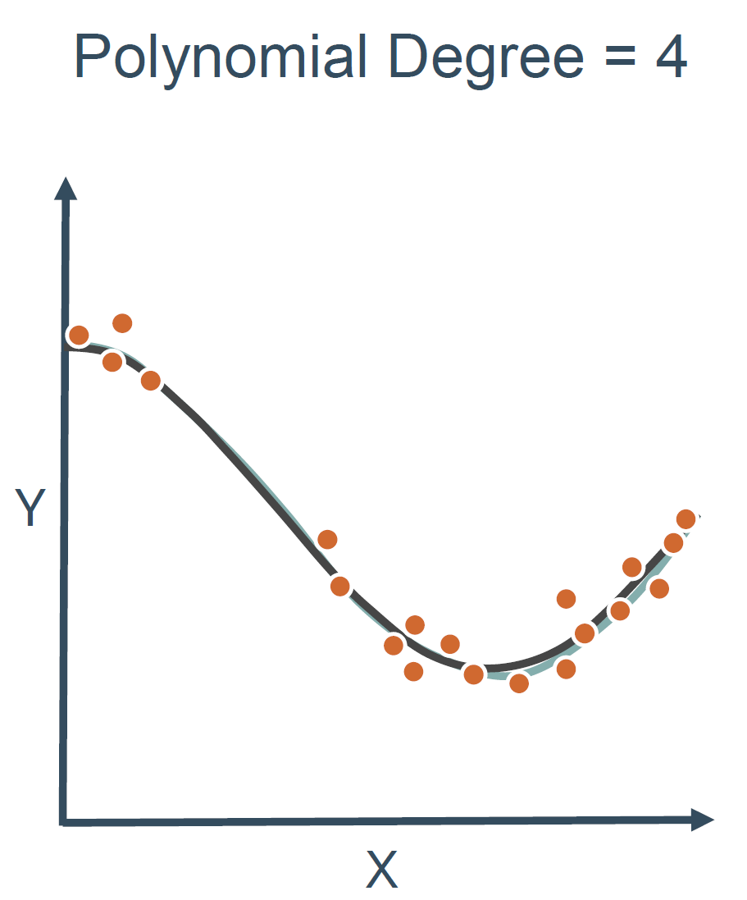
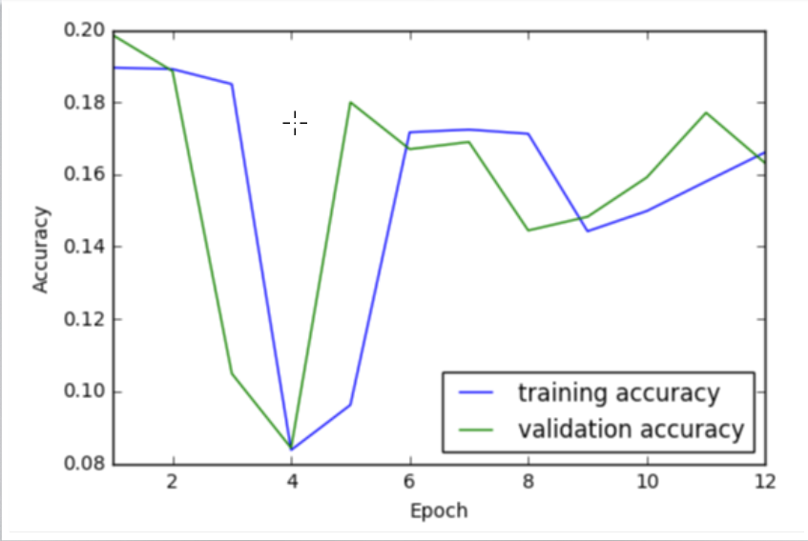
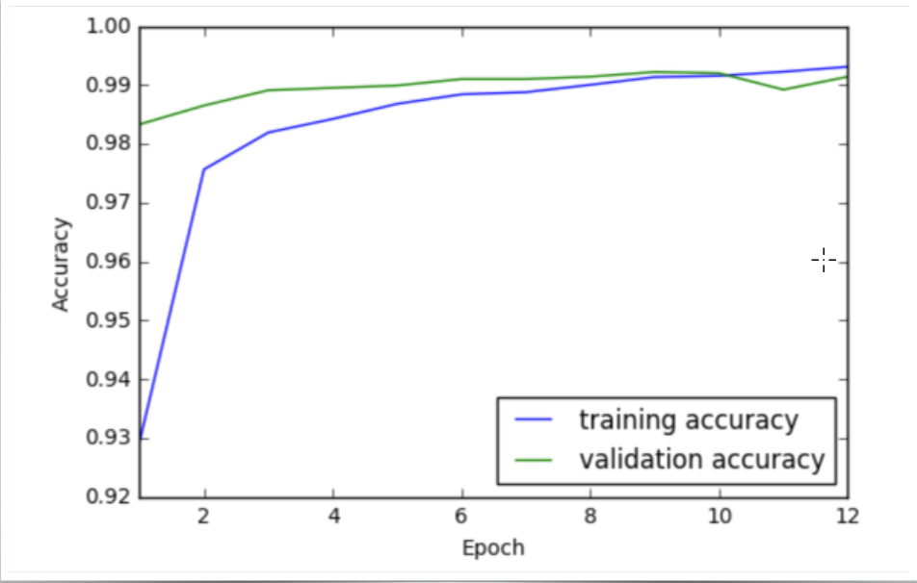
Good fit
More complex model may overfit
Longer training may not help either
We need test data

Slide 16
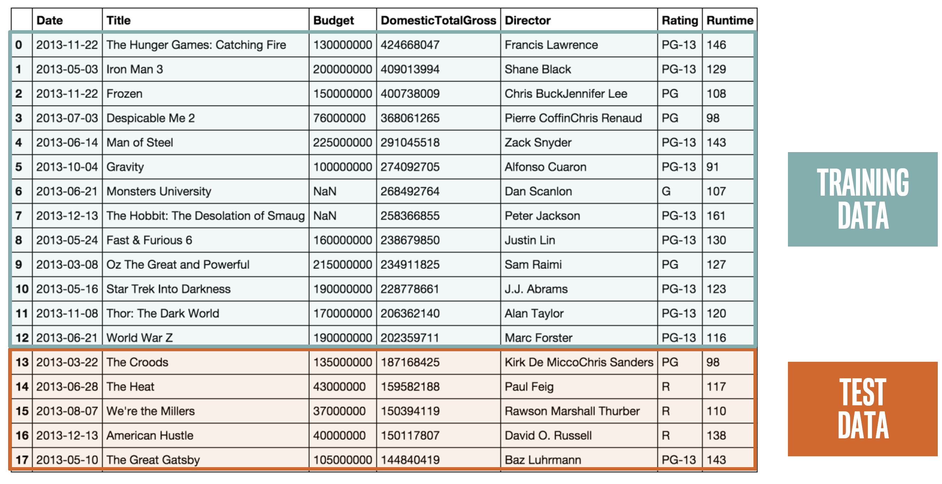
Test data

Slide 17
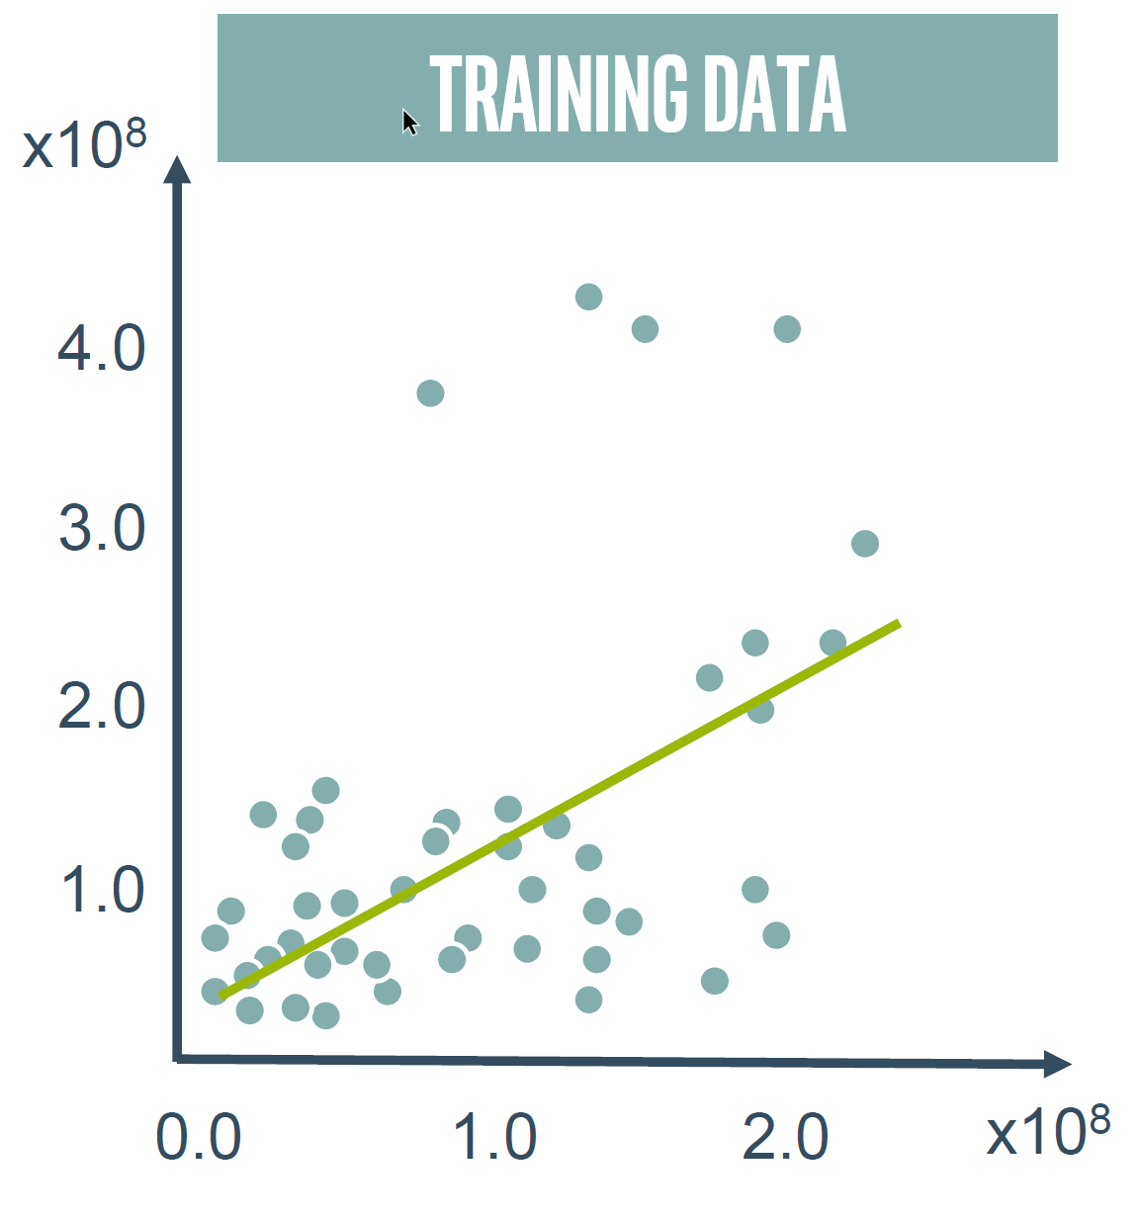
Training data usage
Used for learning, to fit model parameters
Model can learn apparent relationships in the training data that do not hold in general
The Neural Net tank urban legend
More data may help
Reducing model complexity (numbers of parameters) may also help

Slide 18
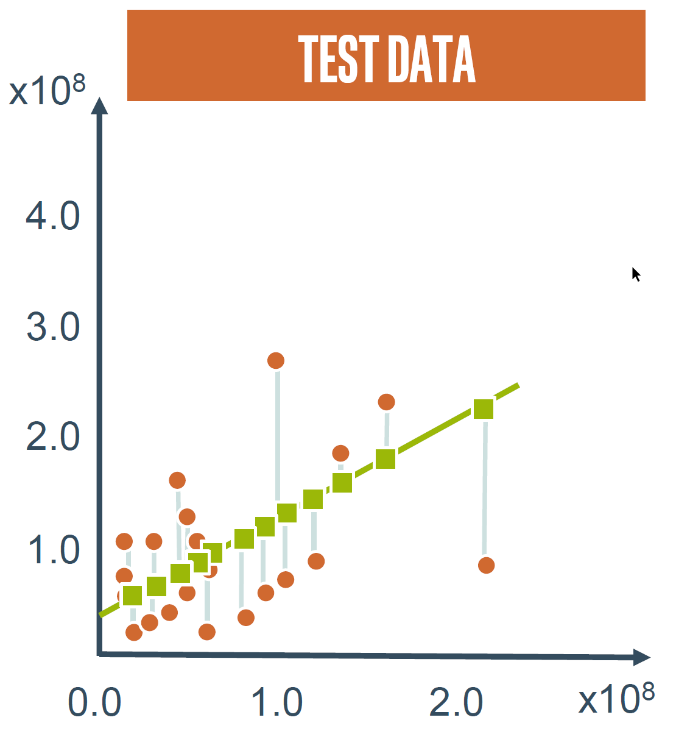
Test data usage
Used for model evaluation
Should be similar to training data
Contains the same patterns, but different random noise
Can be used only once
Looks like we need third data set to optimize models

Slide 19
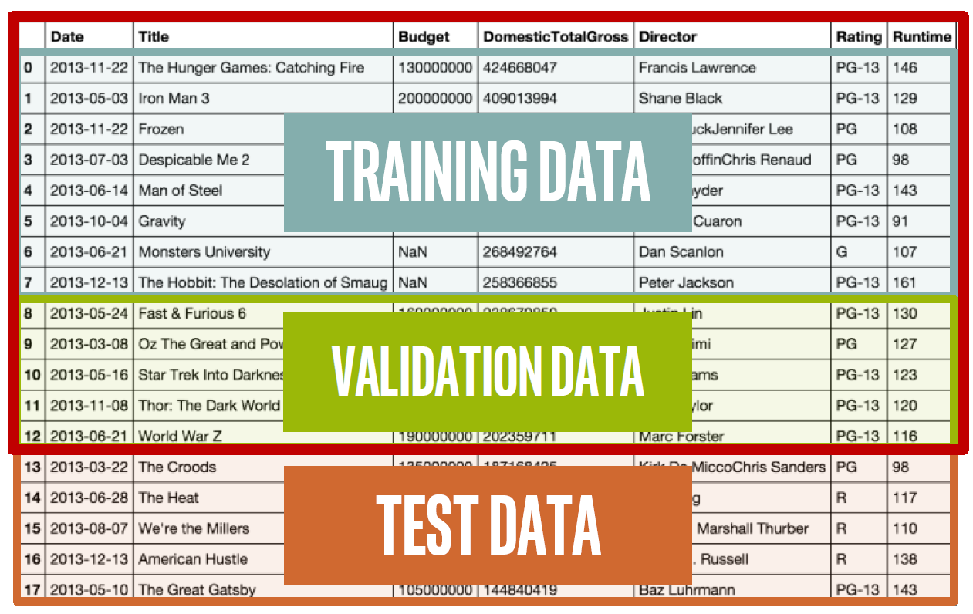
Train, Validation and Test datasets

Slide 20
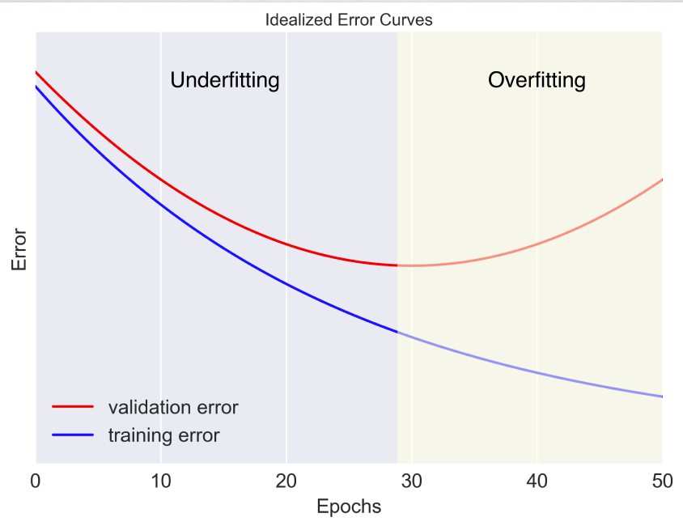
Train, Validation and Test datasets
Validation dataset is used for tuning
To prevent overfitting, watch the error on the validation data
If training error is still declining, but validation (or test) error is going up, the model starts overfit
When you are happy, evaluate the model on test data
By Andrew Glassner, The Imaginary Institute

Slide 21
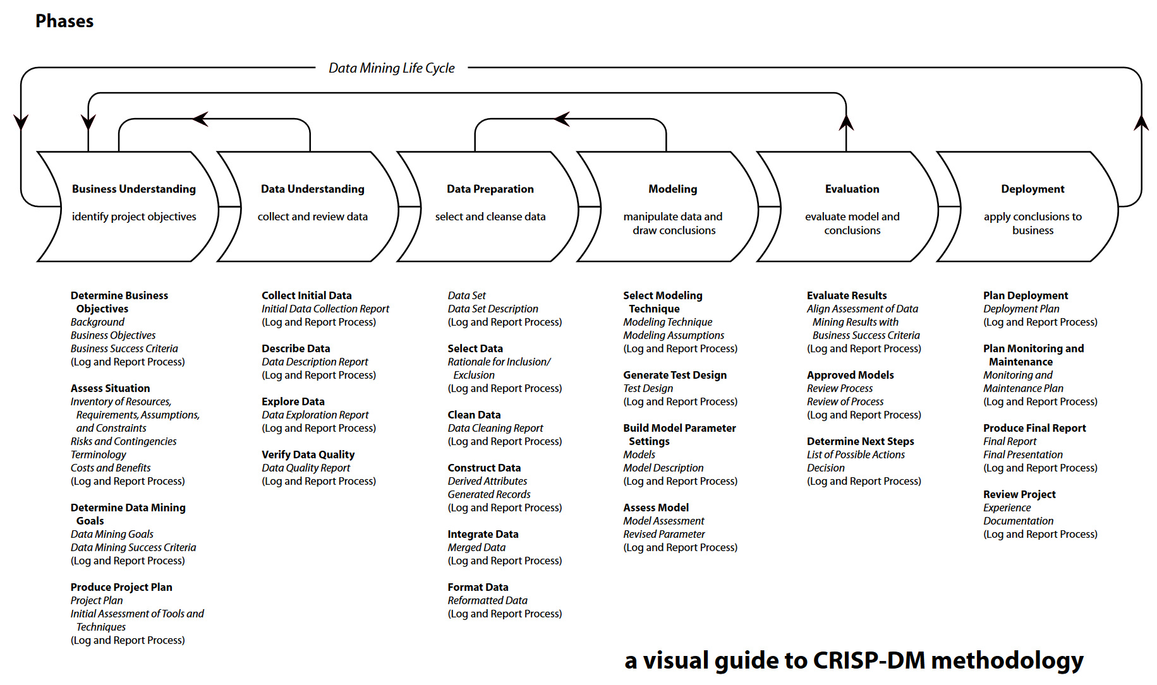
CRISP-DM methodology
Cross-industry standard process for data mining
Conceived in 1996
Provides a structured approach to planning a data mining project
Still in use
SOURCE: CRISP-DM 1.0 http://www.crisp-dm.org/download.htm DESIGN: Nicole Leaper http://www.nicoleleaper.com

Slide 22
SQL Server Machine Learning Services

Slide 23
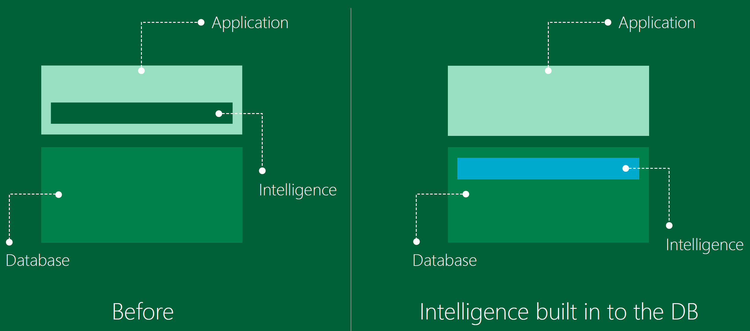
In-database advanced analytics

Slide 24
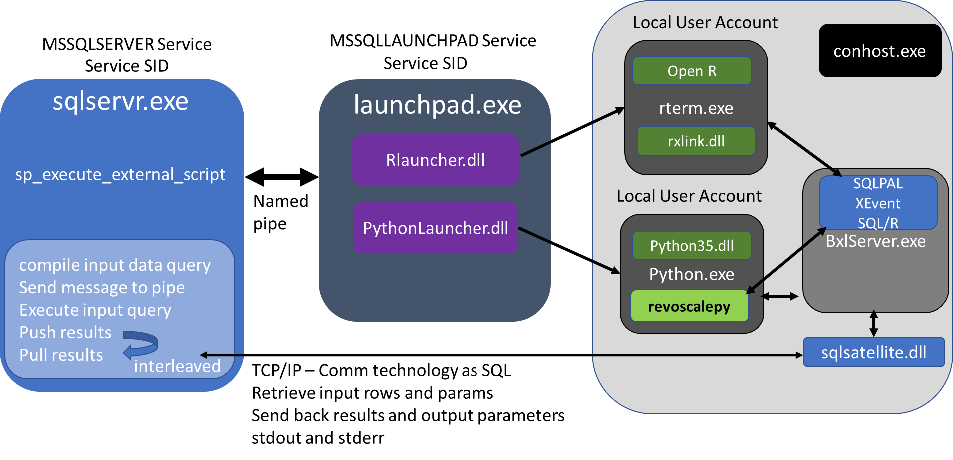
SQL Server Machine Learning Services
By Ginger Grant, http://www.desertislesql.com

Slide 25
SQL Server Extensibility Framework
Host external runtimes securely on SQL Server machine
Resource governance on external processes
EXTERNAL RESOURCE POOL to control CPU, Memory, CPU Affinity
Integrate with SQL query execution
New external script operator to exchange data / parameters
Parallel query pushing data to multiple external processes / threads
Streaming mode execution
Batch mode execution (in SQL Server 2017/2019)
Implied Authentication
Impersonation for loopback connections from external scripts
Just use trusted connection in connection string

Slide 26
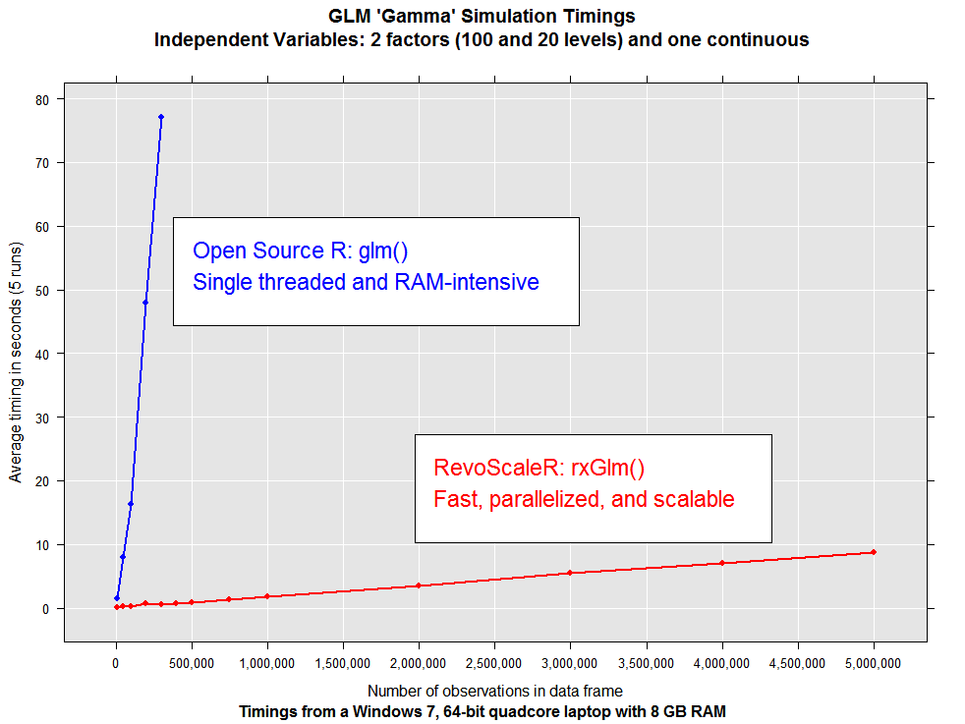
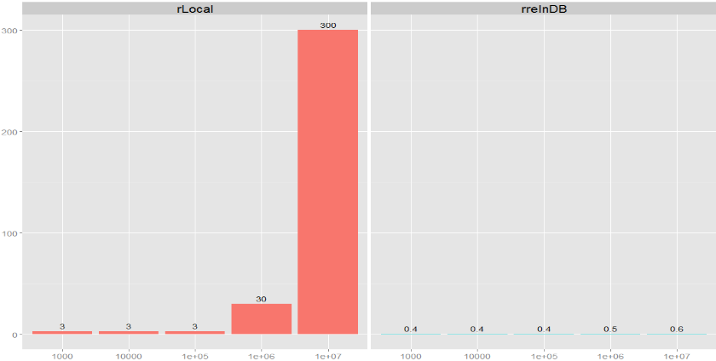
Performance
5+ hours to 40 seconds

Slide 27
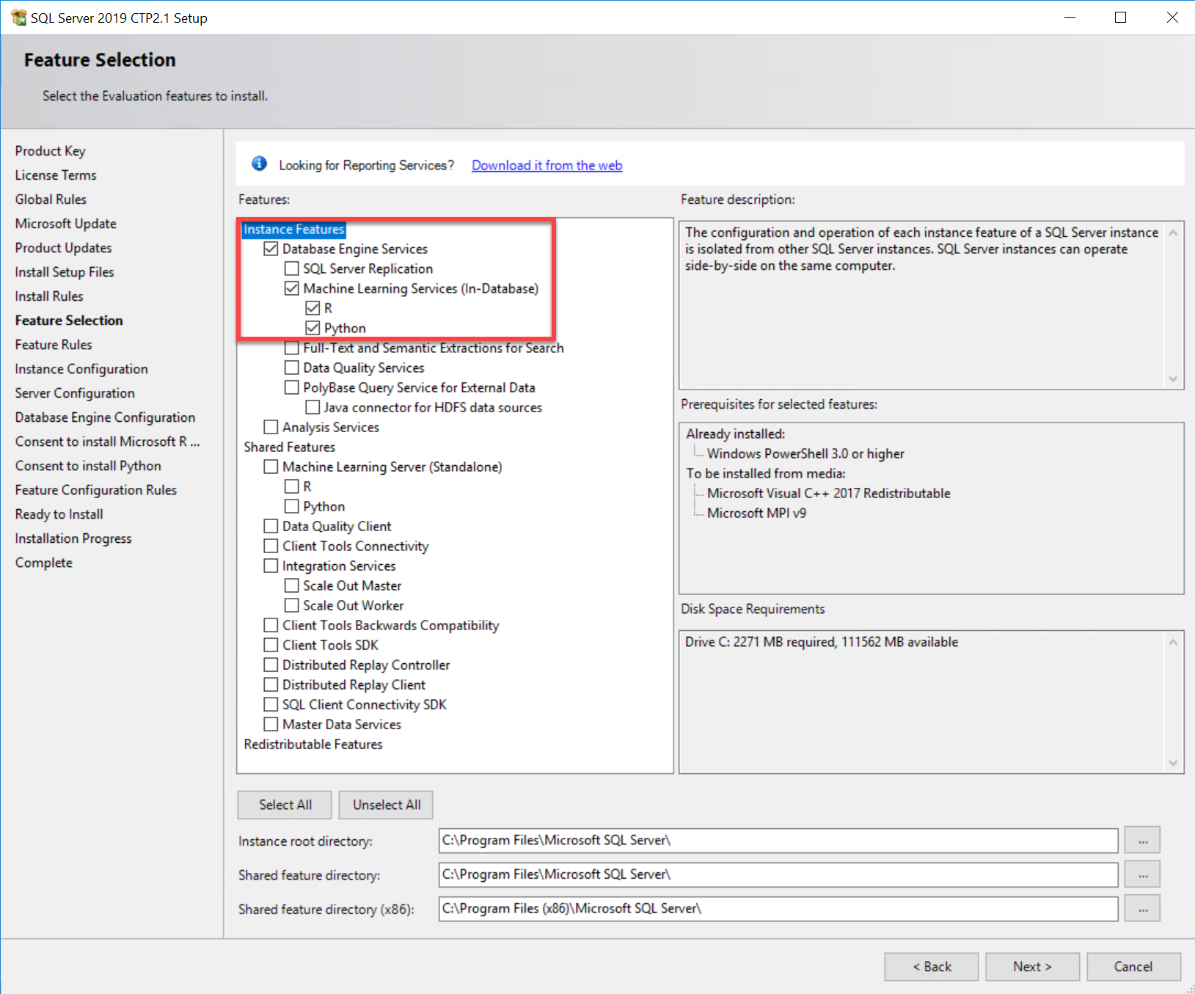
Installation
Two options: In-Database or Standalone
R and Python must be downloaded from Internet
You will need both Microsoft R/Python Open and Microsoft R/Python Server
SQL Server 2017 components
Microsoft R Open 3.3.3 and R Server 9.2.0
Python 3.5 Anaconda with RevoScalePy

Slide 28
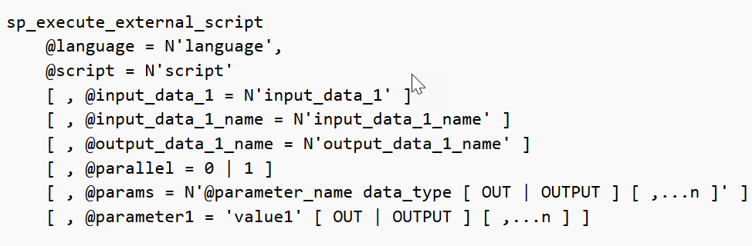
External scripts execution
sp_execute_external_script is a stored procedure that executes a provided script as an argument on an external script to a provided language

Slide 29
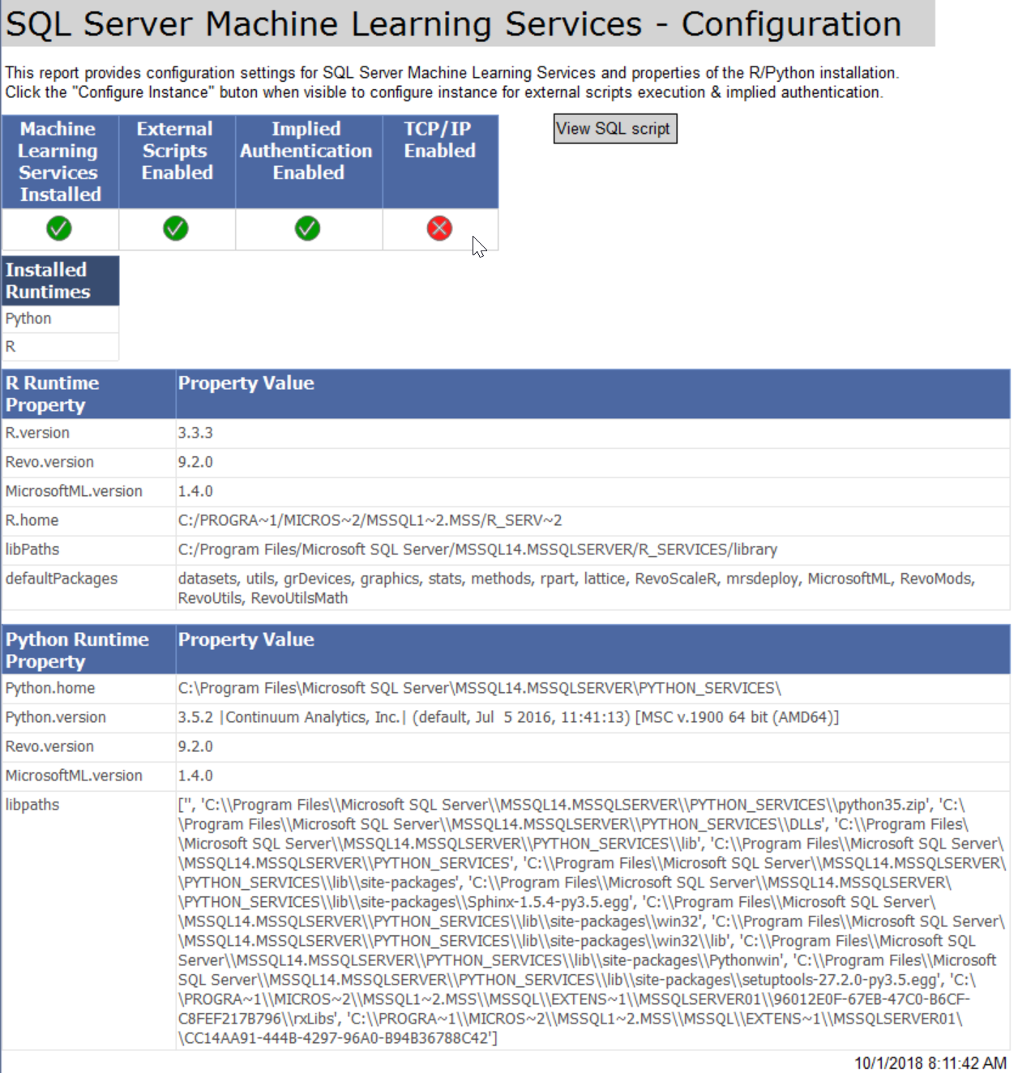
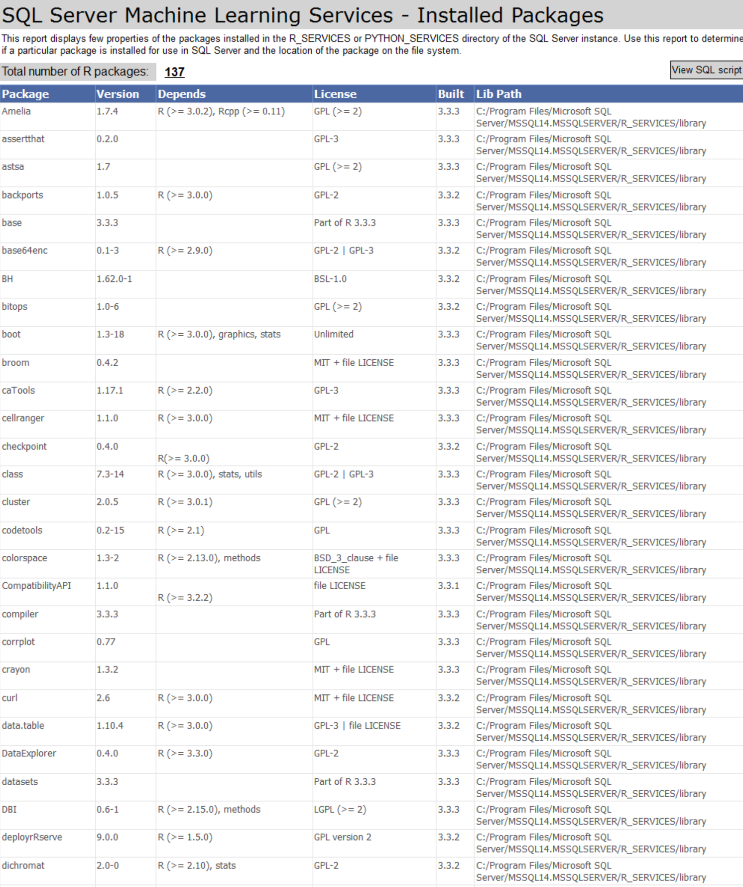
Configuration
https://github.com/Microsoft/sql-server-samples/tree/master/samples/features/machine-learning-services/ssms-custom-reports

Slide 30
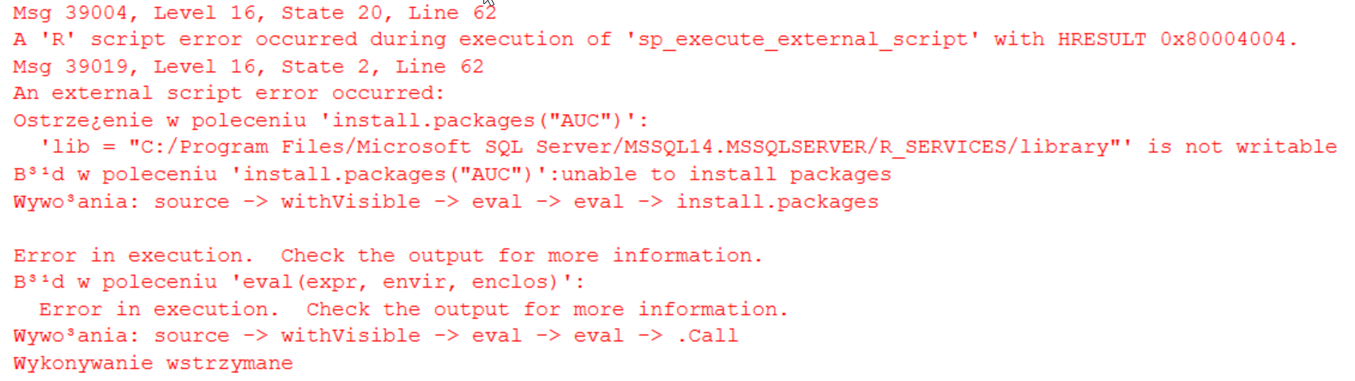
Installing R packages
R Client (R.exe or Rstudio)
xp_cmdshell
rxInstallPackages ScaleR function
In-database Package Management (CREATE EXTERNAL LIBRARY)

Slide 31
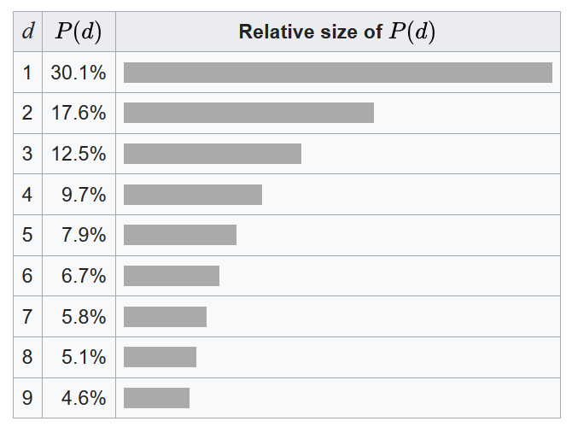
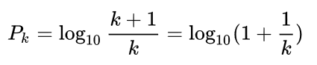
Fraud detection with SQL Server Machine Learning Services
Fraud detection is one of the earliest industrial applications of advanced analytics
The discovery of Benford's law goes back to 1881, when astronomer Simon Newcomb noticed that in logarithm tables the earlier pages were much more worn than the other pages
The phenomenon was again noted in 1938 by the physicist Frank Benford, who tested it on data from 20 different domains

Slide 32
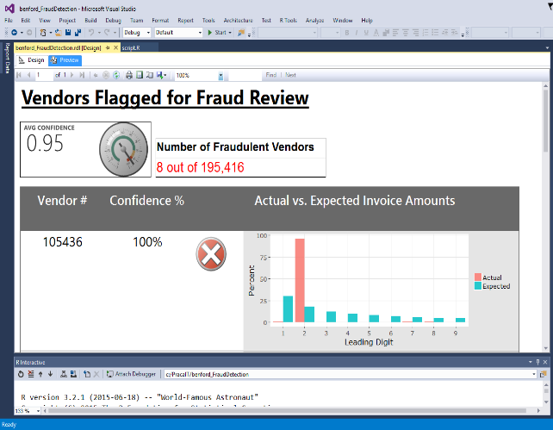
Fraud detection with SQL Server Machine Learning Services
Goals:
Identify fraudulent vendors based on invoice numbers
Operationalize solution using SQL Server ML Services and SSRS
Tasks:
Count first digits frequency - [BenfordFraud].[VendorInvoiceDigits]
Determine whether there is a significant difference between the expected and the observed frequencies - [BenfordFraud].[getPotentialFraudulentVendorsList]
Visualize distribution of leading digits in invoices - [BenfordFraud].[getVendorInvoiceDigits]

Slide 33
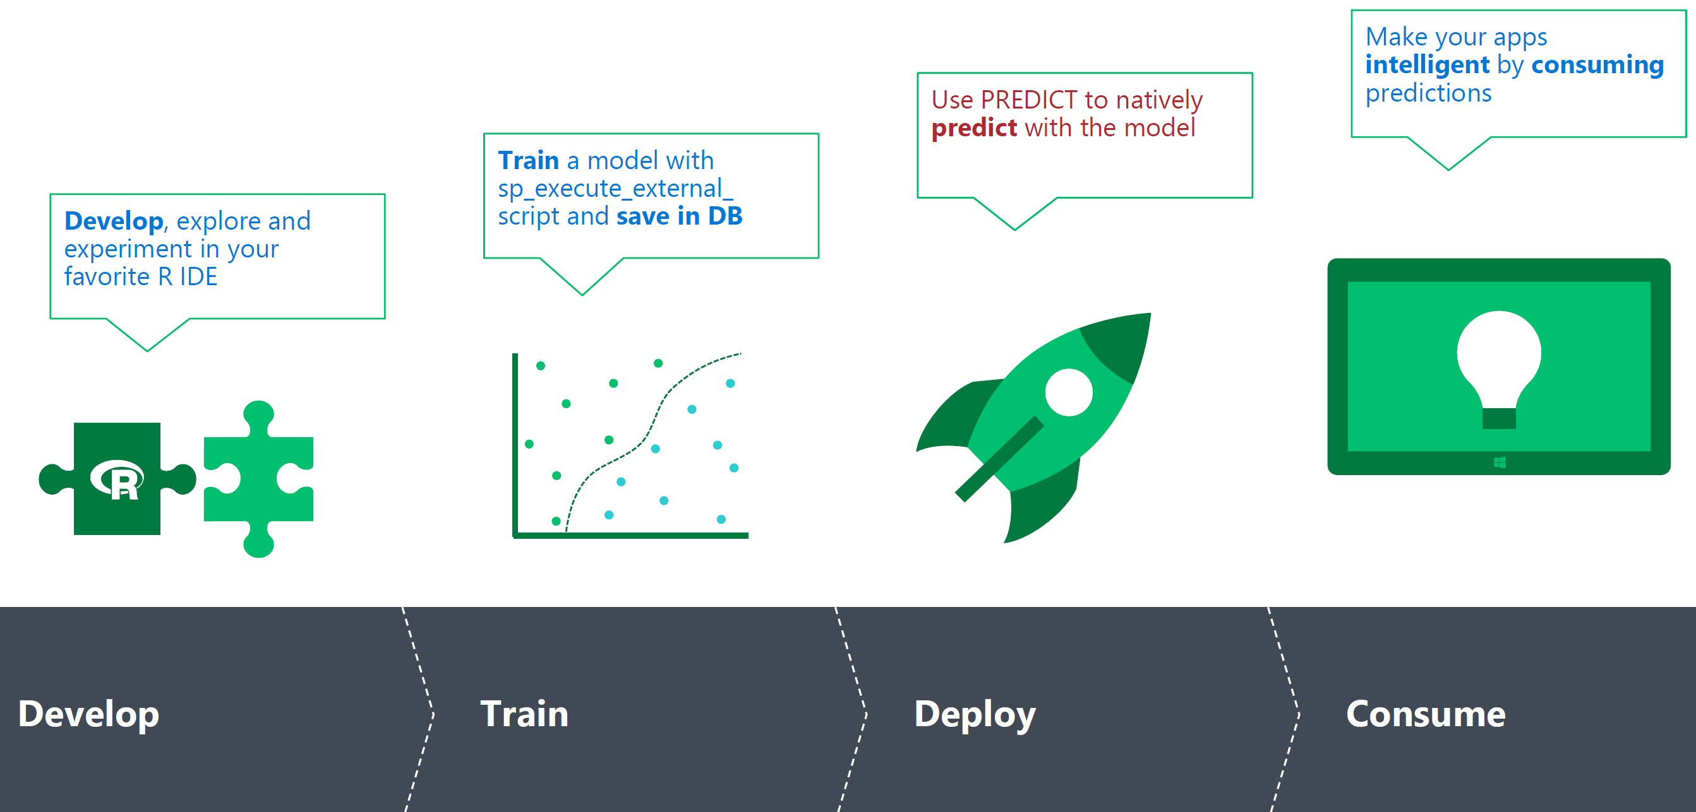
Deploy predictive analytics

Slide 34
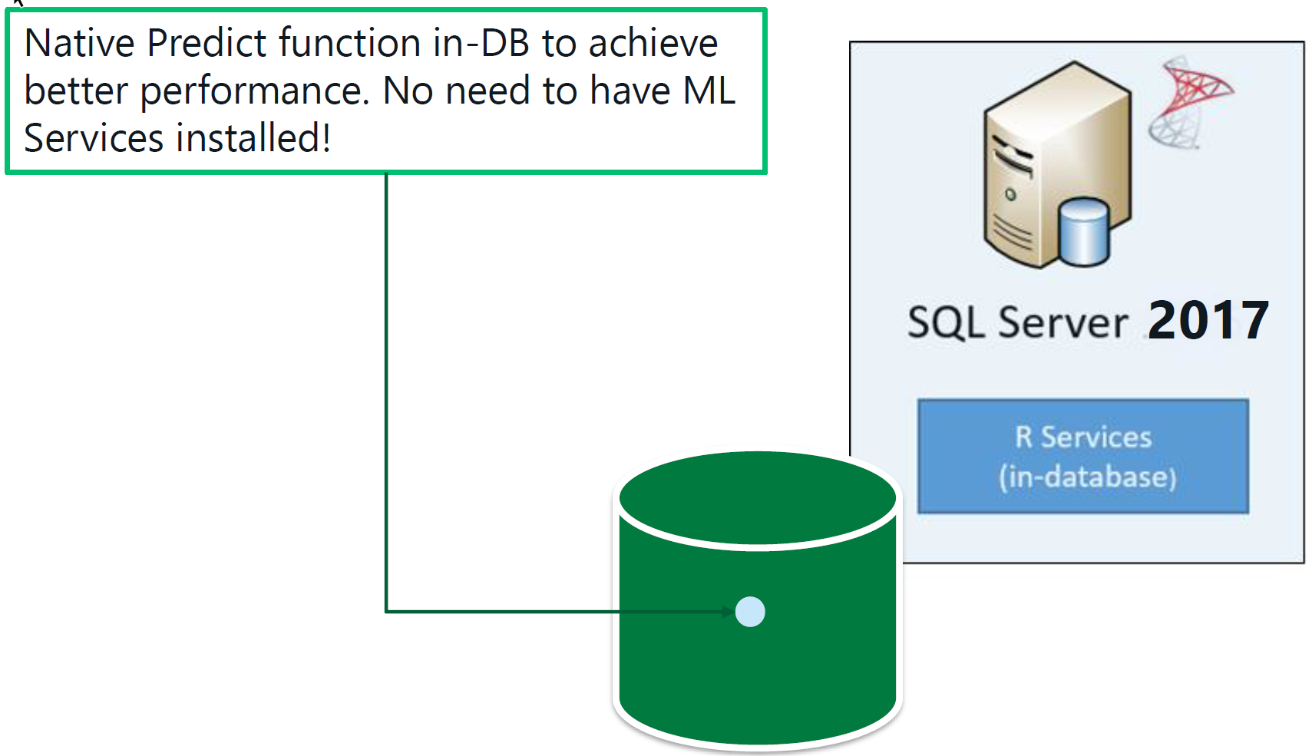
Native Scoring using PREDICT function
Requirements:
rx* models only
Serialized model from rxSerializeModel (R)
Serialized model from rx_serialize_model (Python)
Key Benefits:
Runs natively in SQL Server (No R / Python dependency)
Low latency for execution
Ideal for highly concurrent scoring of few rows
Can be used in INSERT/UPDATE/MERGE statement directly

